Slide 1


Menoufia University
Faculty of Electronic Engineering
Computer Science and Engineering Department
2022 - 2023
Pentor
Personal network inspector
Graduation project Presentation

Slide 2

Team Information
Team Name
Fluteeks team
Derived from Flutter Geeks.
Team Members
Fluteeks team consists of 4 senior CSE students.
Name | Section | Acad. Num.
Aya Islam Gaber Allam | 1 | 1800073
Amira Sami Saad Omar | 1 | 1700067
Ahmed Hosny Salah Ahmed | 1 | 1600432
Mahmoud Nasser Elsayed Mansour ( Leader ) | 4 | 1700245
Supervisor
Dr. Sonia Hashish

Slide 3
AGENDA
Introduction
Background Review
System Analysis
System Design
Implementation
Testing
Conclusion

Slide 4

AGENDA
Introduction
Background Review
System Analysis
System Design
Implementation
Testing
Conclusion

Slide 5
AGENDA
Introduction
Background Review
System Analysis
System Design
Implementation
Testing
Conclusion
Introduction

Slide 6
AGENDA
Introduction
Introduction
Background Review
System Analysis
System Design
Implementation
Testing
Conclusion
Pentor is a cross-platform network monitoring app
It is important to have a tool that can help prevent unauthorized access.
Pentor is here to fill that gap
Project Target
The ordinary users.
Users don’t have to be in an advanced level in networks
Project Scope
Mobile Application
Networking
Security
Cloud Storage

Slide 7
AGENDA
Project Features
Introduction
Background Review
System Analysis
System Design
Implementation
Testing
Conclusion
Display the basic network information
Internet speed test
Ping test
DNS test
Display connected devices information
Display the data usage of the applications.
Display the network logs
Scan the network periodically and notify the user in case of intruders.

Slide 8
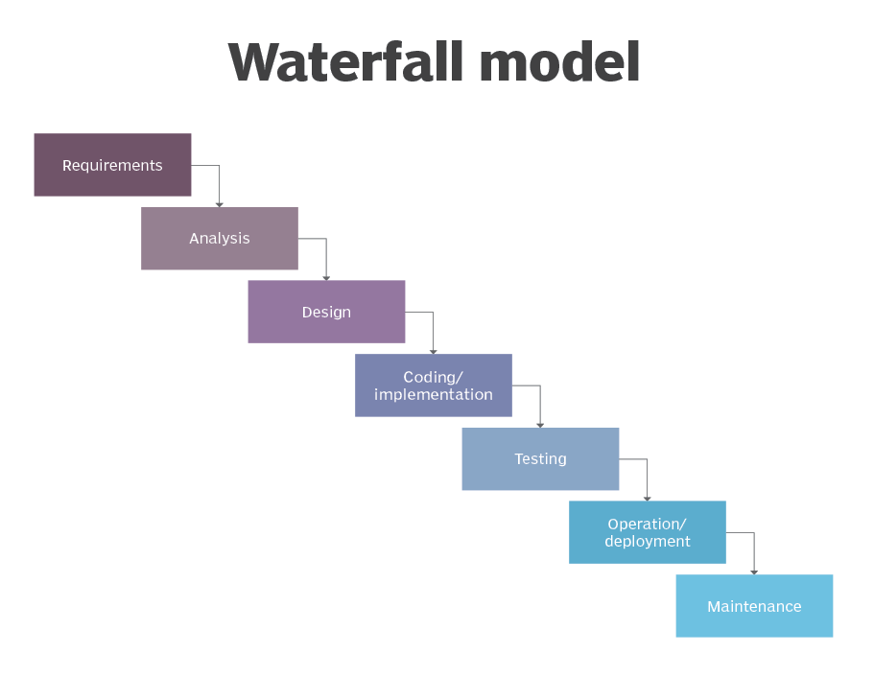
AGENDA
Software Development Approach
Introduction
Background Review
System Analysis
System Design
Implementation
Testing
Conclusion
Waterfall advantages
Easy to Understand and use
Clear milestones
Low risk
Waterfall disadvantages
Inflexible
Poorly suited for complex projects
Poorly suited for long projects

Slide 9
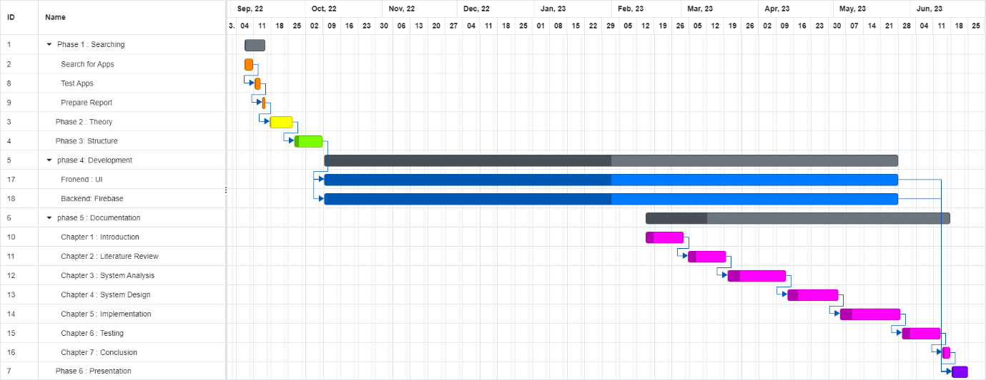
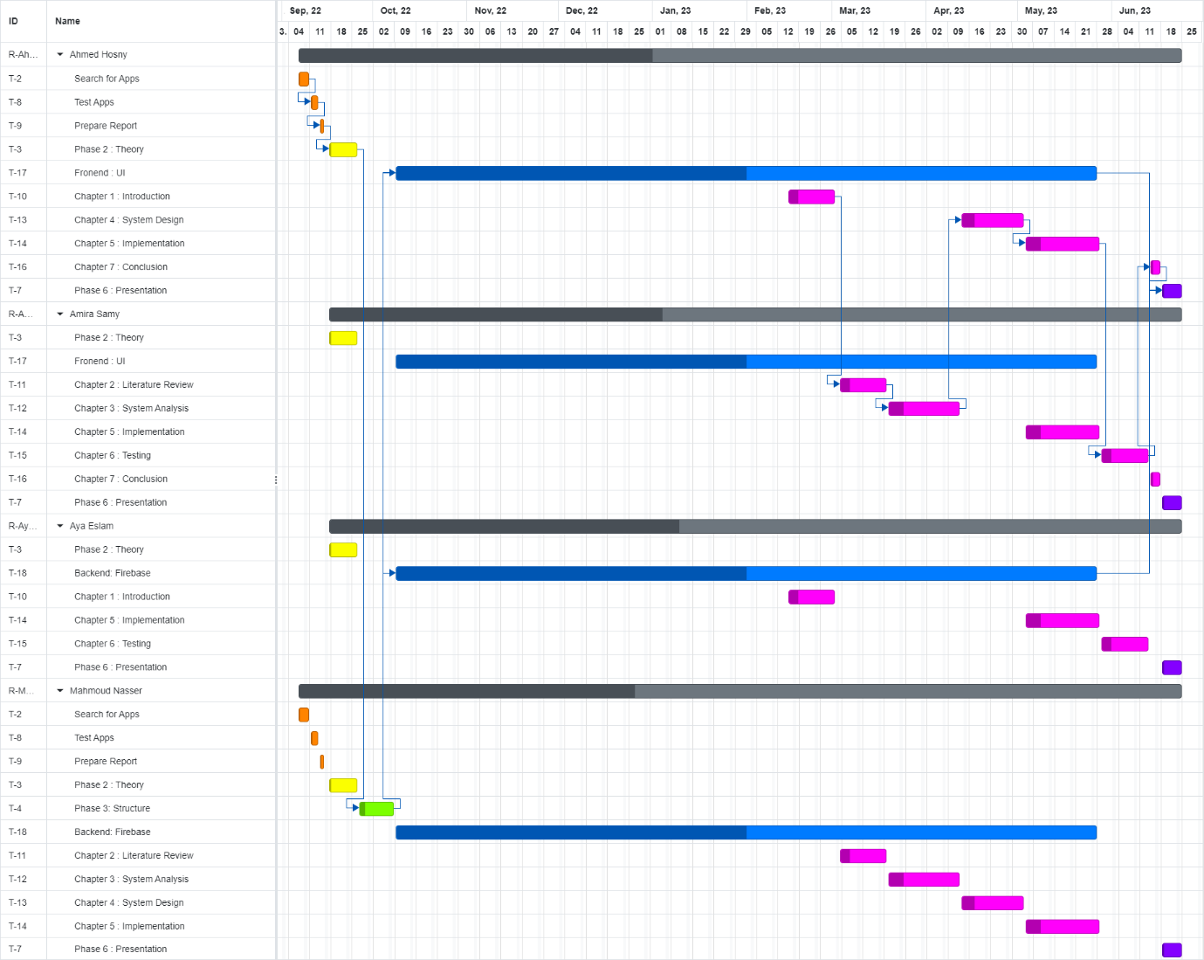
AGENDA
Project Management
Introduction
Background Review
System Analysis
System Design
Implementation
Testing
Conclusion
Both Microsoft Planner and onlinegantt tools were used to manage and schedule tasks as following

Slide 10
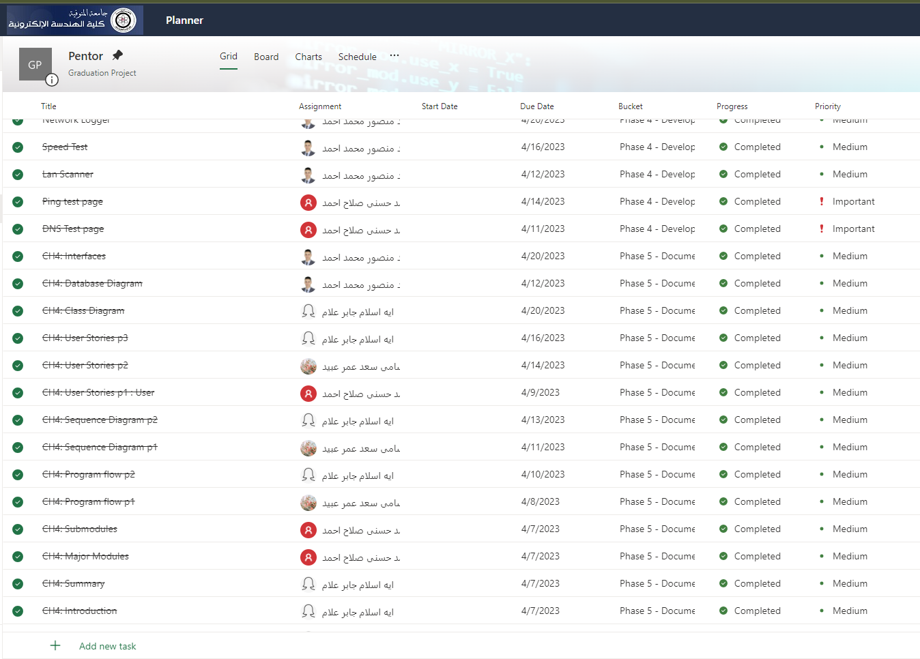
AGENDA
Project Management
Introduction
Background Review
System Analysis
System Design
Implementation
Testing
Conclusion
Both Microsoft Planner and onlinegantt tools were used to manage and schedule tasks as following

Slide 11
AGENDA
Project Management
Introduction
Background Review
System Analysis
System Design
Implementation
Testing
Conclusion
Both Microsoft Planner and onlinegantt tools were used to manage and schedule tasks as following

Slide 12
AGENDA
Introduction
Background Review
System Analysis
System Design
Implementation
Testing
Conclusion
Background Review

Slide 13
AGENDA
Requirements Gathering
Introduction
Background Review
System Analysis
System Design
Implementation
Testing
Conclusion
We conducted a market search on the following list:
PingTools Network Utilities
Wi-Fi Analyzer
IP Tools - Network Utilities
Network Monitor Mini
3G Watchdog - Data Usage
Fing - Network Tools
Router Chef
Wi-Fi Blocker
3G Watchdog - Data Usage
Router Chef
Internet Speed Meter Lite
Who Uses My WiFi Pro

Slide 14

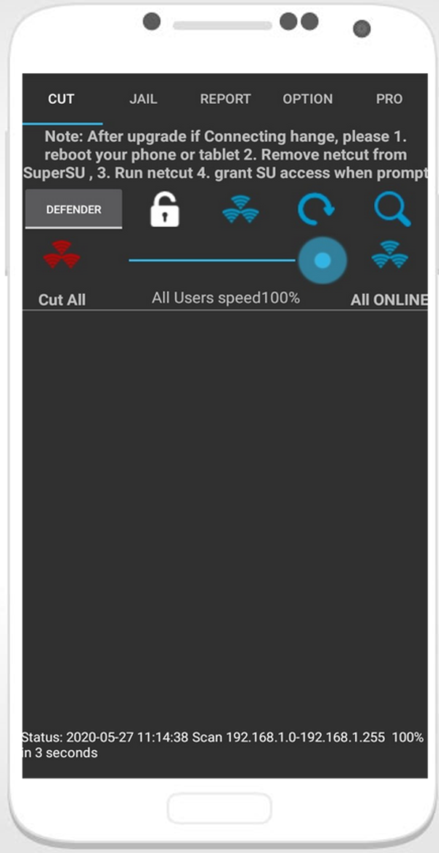
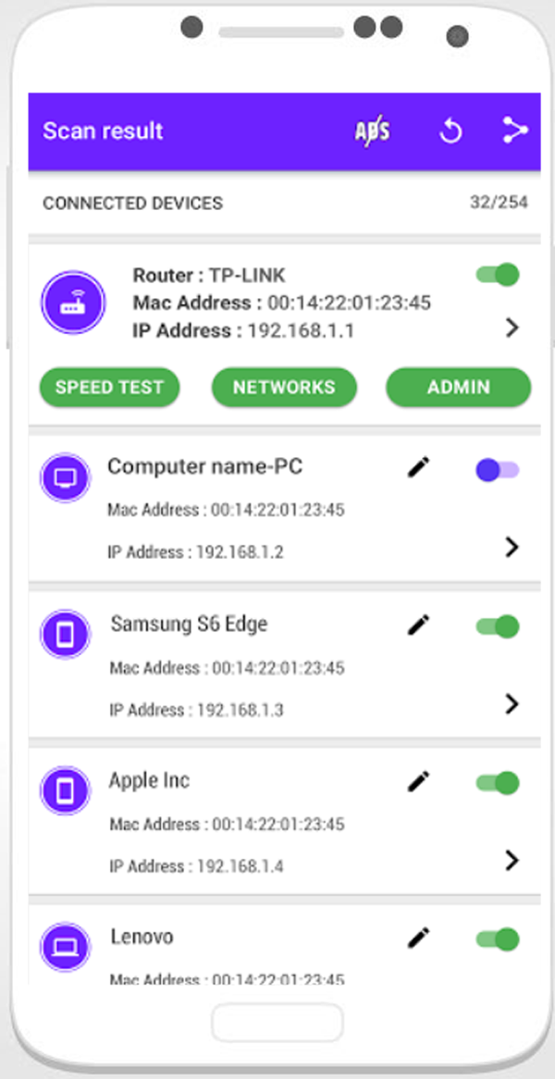
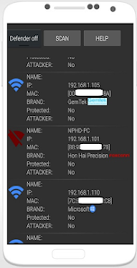
AGENDA
Similar Systems
Introduction
Background Review
System Analysis
System Design
Implementation
Testing
Conclusion
1. Netcut pro for android 2021
Disable (shutdown) the internet connection of other devices connected to the same Wi-Fi network

Slide 15

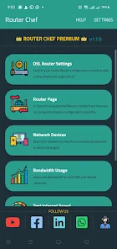
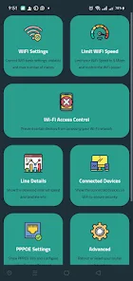
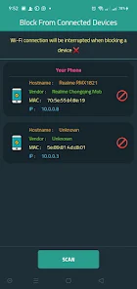
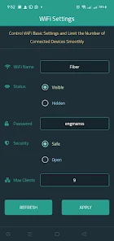
AGENDA
Similar Systems
Introduction
Background Review
System Analysis
System Design
Implementation
Testing
Conclusion
2. Router Chef
Change Wi-Fi SSID or Password
Limit Wi-Fi speed
Control the Wi-Fi signal strength
Show the active connected devices on Wi-Fi
Reboot and reset the Router to factory settings
Change DNS
Show daily internet usage or from a specific date
Access to the Router configuration page

Slide 16
Similar Systems
AGENDA
Introduction
Background Review
System Analysis
System Design
Implementation
Testing
Conclusion

Slide 17
AGENDA
Requirements Gathering
Introduction
Background Review
System Analysis
System Design
Implementation
Testing
Conclusion
What network monitoring apps lack :
Easy to use and understand
Support of multiple languages
App that doesn’t require root privileges.
All in one app
Open-source app
Free app available to everybody with no annoying ads.

Slide 18
AGENDA
Introduction
Background Review
System Analysis
System Design
Implementation
Testing
Conclusion

Slide 19
AGENDA
Introduction
Background Review
System Analysis
System Design
Implementation
Testing
Conclusion
System Analysis

Slide 20


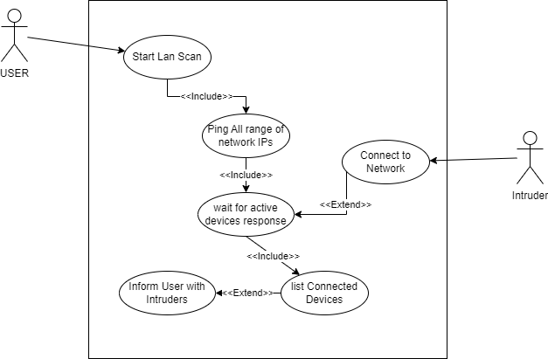
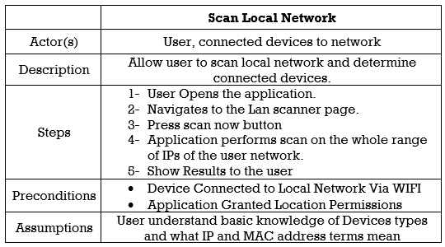
System Requirements
System User
Functional & Data Requirements
Use Cases
Use Case diagram
Use Case Scenario
AGENDA
Introduction
Background Review
System Analysis
System Design
Implementation
Testing
Conclusion

Slide 21



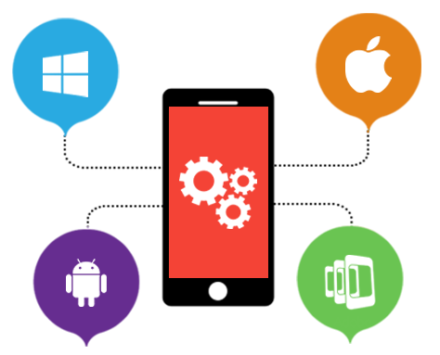

Non-functional requirements
Look and feel requirements
Security requirements
Privacy requirements
Portability requirements
Availability requirements
AGENDA
Introduction
Background Review
System Analysis
System Design
Implementation
Testing
Conclusion

Slide 22
AGENDA
Introduction
Background Review
System Analysis
System Design
Implementation
Testing
Conclusion
Features Illustration

Slide 23
AGENDA
Features Illustration
Introduction
Background Review
System Analysis
System Design
Implementation
Testing
Conclusion
Connection Info
Lan Scanning
Speed Test
Ping Test
DNS Test
Data Usage

Slide 24
AGENDA
Features Illustration
Introduction
Background Review
System Analysis
System Design
Implementation
Testing
Conclusion
Connection Info
Lan Scanning
Speed Test
Ping Test
DNS Test
Data Usage
Application
ask for data
Mobile System
Check
Permission
return data
WI-FI connection Information
Require : Location Permission
Mobile Data Information
Require : Phone Permission

Slide 25
AGENDA
Features Illustration
Introduction
Background Review
System Analysis
System Design
Implementation
Testing
Conclusion
Connection Info
Lan Scanning
Speed Test
Ping Test
DNS Test
Data Usage
Mobile System
ask for
WI-FI info
Application
ping
All Network address
connected
devices response
return data

Slide 26
AGENDA
Features Illustration
Introduction
Background Review
System Analysis
System Design
Implementation
Testing
Conclusion
Connection Info
Lan Scanning
Speed Test
Ping Test
DNS Test
Data Usage
Mobile
request download file
File Server
send file
calculate download speed
upload file
acknowledge upload
calculate upload speed

Slide 27
AGENDA
Features Illustration
Introduction
Background Review
System Analysis
System Design
Implementation
Testing
Conclusion
Connection Info
Lan Scanning
Speed Test
Ping Test
DNS Test
Data Usage
Mobile
ICMP echo
Device
ICMP echo reply

Slide 28
AGENDA
Features Illustration
Introduction
Background Review
System Analysis
System Design
Implementation
Testing
Conclusion
Connection Info
Lan Scanning
Speed Test
Ping Test
DNS Test
Data Usage
Mobile
DNS Query
DNS Server
DNS response

Slide 29
AGENDA
Features Illustration
Introduction
Background Review
System Analysis
System Design
Implementation
Testing
Conclusion
Connection Info
Lan Scanning
Speed Test
Ping Test
DNS Test
Data Usage
calculate applications usage
Mobile System
Application
request applications usage
return data
Permission : PACKAGE_USAGE_STATS

Slide 30
AGENDA
Introduction
Background Review
System Analysis
System Design
Implementation
Testing
Conclusion
System Design

Slide 31
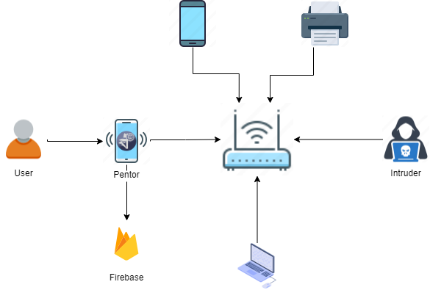
AGENDA
The mobile app System Architecture components
Network Communication
Device Compatibility
User Interface (UI)
Application Logic
Data Storage
Security
Introduction
Background Review
System Analysis
System Design
Implementation
Testing
Conclusion
Flutter
Flutter
Flutter
Flutter
Firebase
Firebase

Slide 32
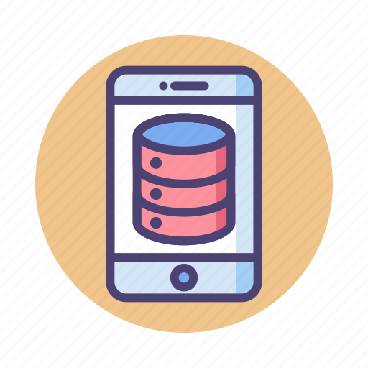






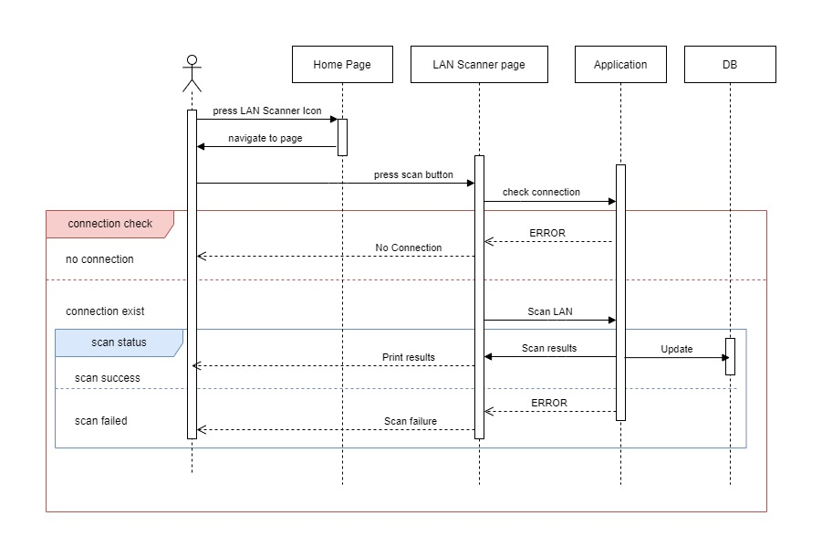
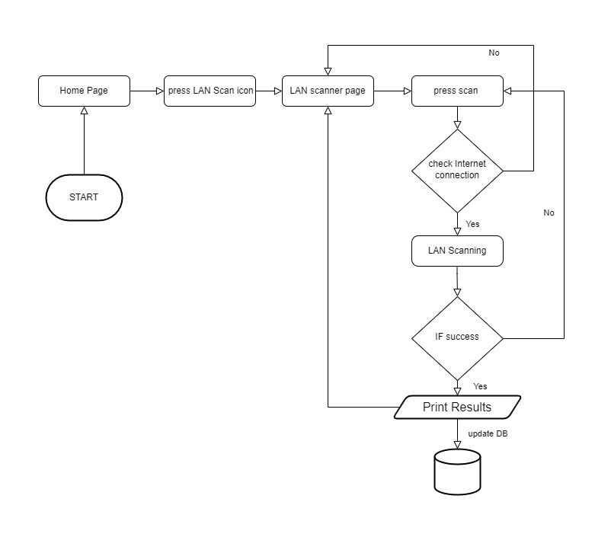
System Architecture
Major Modules : Mobile application and Database
Sub Modules : external APIs and SDKs
Program Flow
Sequence Diagrams
AGENDA
Introduction
Background Review
System Analysis
System Design
Implementation
Testing
Conclusion

Slide 33
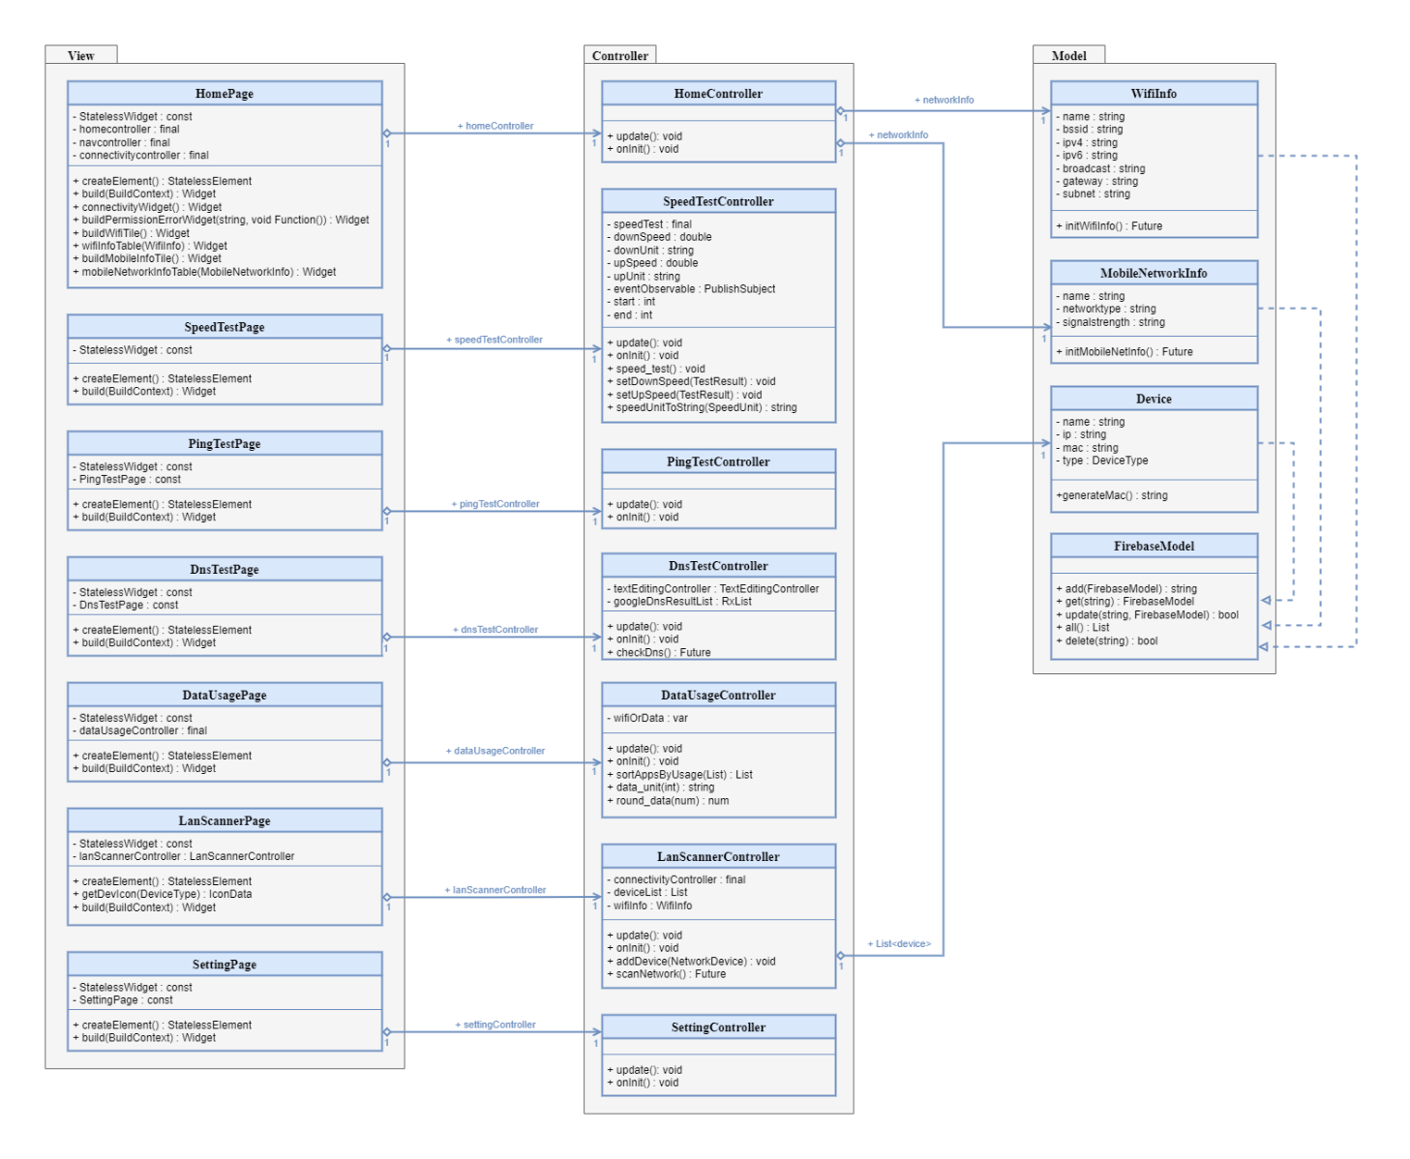
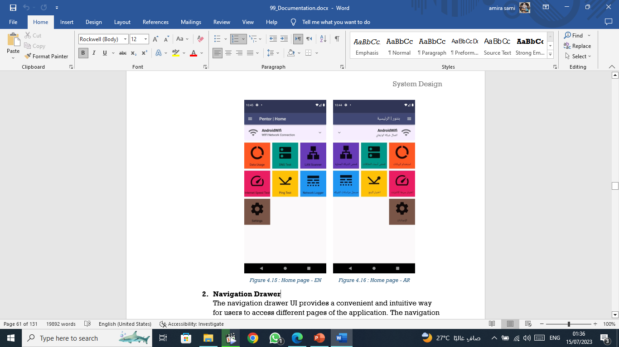
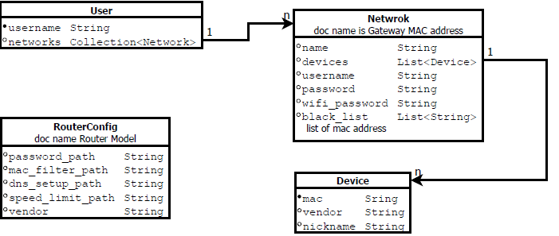
Detailed System Design
User Stories
Class Diagram
Database Design
Interfaces
AGENDA
Introduction
Background Review
System Analysis
System Design
Implementation
Testing
Conclusion

Slide 34
AGENDA
Introduction
Background Review
System Analysis
System Design
Implementation
Testing
Conclusion

Slide 35
AGENDA
Introduction
Background Review
System Analysis
System Design
Implementation
Testing
Conclusion
Implementation

Slide 36
AGENDA
Development Environment
Introduction
Background Review
System Analysis
System Design
Implementation
Testing
Conclusion
Dart | Programming Language
Flutter | Development Framework
Android & IOS | Platform
Firebase | Cloud Storage

Slide 37

AGENDA
Frontend Architecture
Introduction
Background Review
System Analysis
System Design
Implementation
Testing
Conclusion
Flutter Framework
Flutter is an open-source mobile application development framework created by Google.
It allows developers to build high-performance, cross-platform mobile applications for iOS and Android using a single codebase.
Flutter uses the Dart programming language, which is also developed by Google.

Slide 38

AGENDA
Backend Architecture
Introduction
Background Review
System Analysis
System Design
Implementation
Testing
Conclusion
Google Firebase
is a mobile and web application development platform that provides developers with a range of tools and services to build high-quality applications.
Firebase offers a wide range of features including:
Real-time database
Authentication
Cloud messaging
Hosting
Analytics
Connecting Pentor with Database
Added the Firebase SDK dependencies to project.
configured Firebase in app.

Slide 39
Coding Examples
Home page
This is the landing page of the application which consisted of:
- Connectivity widget
- Navigation Grid
AGENDA
Introduction
Background Review
System Analysis
System Design
Implementation
Testing
Conclusion

Slide 40
Following method return the connectivity widget
AGENDA
Introduction
Background Review
System Analysis
System Design
Implementation
Testing
Conclusion
Widget connectivityWidget() {
switch (_connectivityController.connectivityStatus) {
case ConnectivityResult.none:
return ListTile(
tileColor: Themes.backgroundColor,
leading: Icon(
Icons.not_interested,
size: 50.0,
),
title: Text("NOT CONNECTED".tr,
style: TextStyle(fontSize: 18, fontWeight: FontWeight.bold)),
subtitle: Text("No Connection Found".tr),
);
case ConnectivityResult.wifi:
return buildWifiTile();
case ConnectivityResult.mobile:
return buildMobileInfoTile();
default:
return ListTile(
tileColor: Themes.accentColor,
leading: Icon(
Icons.error_outline,
color: Colors.red,
size: 50.0,
),
title: Text("ERROR".tr,
style: TextStyle(fontSize: 18, fontWeight: FontWeight.bold)),
subtitle: Text("CONNECTION ERROR".tr),
);
}:

Slide 41
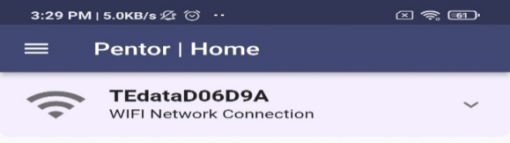
In case of Wifi Connected WifiTile is shown using the following method :
AGENDA
Widget buildWifiTile() {
return FutureBuilder<WifiInfo>(
future: _connectivityController.getWifiInfo,
builder: (_, snapshot) {
if (snapshot.hasError) {
return buildPermissionErrorWidget(snapshot.error.toString(),
_connectivityController.askForLocationPermission);
} else {
switch (snapshot.connectionState) {
case ConnectionState.done:
WifiInfo wifiInfo = snapshot.data!;
return ExpansionTileCard(
expandedTextColor: Themes.primaryColor,
leading: Icon(
Icons.wifi,
size: 50.0,
),
title: Text(wifiInfo.name,
style:
TextStyle(fontSize: 18, fontWeight: FontWeight.bold)),
subtitle: Text("WIFI Network Connection".tr),
children: [
wifiInfoTable(wifiInfo),
],
);
default:
//TODO: Other switch cases
return Container();
}
}
});
}
Introduction
Background Review
System Analysis
System Design
Implementation
Testing
Conclusion

Slide 42
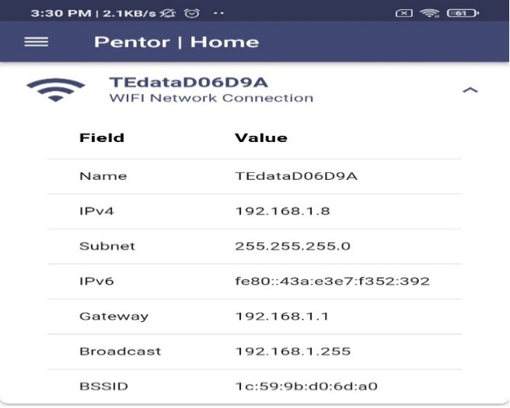
For more information about WIFI:
AGENDA
Widget wifiInfoTable(WifiInfo wifiInfo) {
return DataTable(columns: [
DataColumn(
label: Text('Field'.tr,
style: TextStyle(fontSize: 16, fontWeight: FontWeight.bold))),
DataColumn(
label: Text('Value'.tr,
style: TextStyle(fontSize: 16, fontWeight: FontWeight.bold))),
], rows: [
DataRow(cells: [
DataCell(Text('Name'.tr)),
DataCell(Text(wifiInfo.name)),]),
DataRow(cells: [
DataCell(Text('IPv4')),
DataCell(Text(wifiInfo.ipv4)),]),
DataRow(cells: [
DataCell(Text('Subnet')),
DataCell(Text(wifiInfo.subnet)), ]),
DataRow(cells: [
DataCell(Text('IPv6')),
DataCell(Text(wifiInfo.ipv6)),
]),
DataRow(cells: [
DataCell(Text('Gateway'.tr)),
DataCell(Text(wifiInfo.gateway)),
]),
DataRow(cells: [
DataCell(Text('Broadcast'.tr)),
DataCell(Text(wifiInfo.broadcast.toString().replaceAll('/', ''))) ]),
DataRow(cells: [
DataCell(Text('BSSID')),
DataCell(Text(wifiInfo.bssid)) ]),]);
}
Introduction
Background Review
System Analysis
System Design
Implementation
Testing
Conclusion

Slide 43
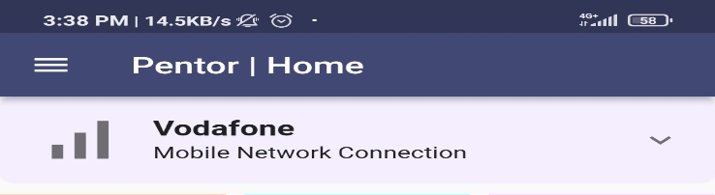
In case of Mobile data connected the connectivity tile shows the mobileInfoTile using the following method:
AGENDA
Widget buildMobileInfoTile() {
return FutureBuilder<MobileNetworkInfo>(
future: _connectivityController.getMobileNetworkInfo,
builder: (_, snapshot) {
if (snapshot.hasError) {
return buildPermissionErrorWidget(snapshot.error.toString(),
_connectivityController.askForPhonePermission);
} else {
switch (snapshot.connectionState) {
case ConnectionState.done:
MobileNetworkInfo mobileNetworkInfo = snapshot.data!;
return ExpansionTileCard(
expandedTextColor: Themes.primaryColor,
leading: Icon(
Icons.signal_cellular_alt, size: 50.0,),
title: Text(mobileNetworkInfo.name,
style:
TextStyle(fontSize: 18, fontWeight: FontWeight.bold)),
subtitle: Text("Mobile Network Connection".tr),
children: [mobileNetworkInfoTable(mobileNetworkInfo)],
);
default:
return Container();
}
}
});
}
Introduction
Background Review
System Analysis
System Design
Implementation
Testing
Conclusion

Slide 44
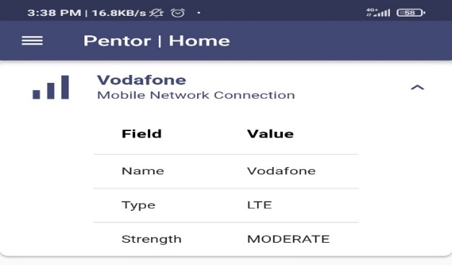
The using method:
AGENDA
Widget mobileNetworkInfoTable(MobileNetworkInfo
mobileNetworkInfo) {
return DataTable(columns: [
DataColumn(
label: Text('Field'.tr,
style: TextStyle(fontSize: 16, fontWeight: FontWeight.bold))),
DataColumn(
label: Text('Value'.tr,
style: TextStyle(fontSize: 16, fontWeight: FontWeight.bold))),
], rows: [
DataRow(cells: [
DataCell(Text('Name'.tr)),
DataCell(Text(mobileNetworkInfo.name)), ]),
DataRow(cells: [
DataCell(Text('Type'.tr)),
DataCell(Text(mobileNetworkInfo.networkType)),]),
DataRow(cells: [
DataCell(Text('Strength'.tr)),
DataCell(Text(mobileNetworkInfo.signalStrength.tr)),
]),
]);
}
}
Introduction
Background Review
System Analysis
System Design
Implementation
Testing
Conclusion

Slide 45
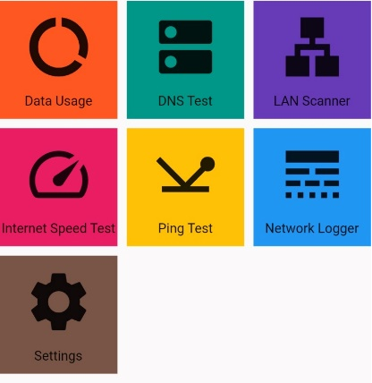
Navigation Grid
To Navigate to each page if the system navigation grid is build using the following code:
AGENDA
GridView.builder(
itemCount: _navController.pages.length,
gridDelegate: SliverGridDelegateWithFixedCrossAxisCount(
crossAxisCount: 3, crossAxisSpacing: 10.0,
mainAxisSpacing: 10.0),
itemBuilder: (BuildContext context, int index){
NavPage page = _navController.pages[index];
return InkWell(onTap: page.action,
child: Container(color: page.color,
child: Column(
mainAxisAlignment: MainAxisAlignment.spaceEvenly,
children: [ Icon( page.icon,size: 75.0,),Text(page.title.tr)
], ), ), ); }, ),
Introduction
Background Review
System Analysis
System Design
Implementation
Testing
Conclusion

Slide 46
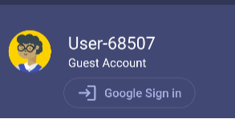
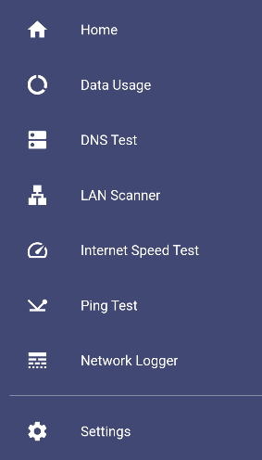
5.3.11 Navigation Drawer
Has two functions as following:
1.Google login tile
2.Navigation List
AGENDA
Introduction
Background Review
System Analysis
System Design
Implementation
Testing
Conclusion

Slide 47
The code of navigation list is as following:
AGENDA
return ListTile(
leading: Icon(icon, color: Colors.white),
title: Text(text, style: textStyle),
onTap: onClicked,); }
// On Scaffold we put
buildMenuItem(
text: 'Home'.tr, icon: Icons.home,
onClicked: _navController.openHomePage),
buildMenuItem(
text: 'Data Usage'.tr,icon: Icons.data_usage,
onClicked: _navController.openDataUsagePage),
buildMenuItem(
text: 'DNS Test'.tr,icon: Icons.dns,
onClicked: _navController.openDnsTestPage),
buildMenuItem(
text: 'LAN Scanner'.tr,icon: Icons.lan,
onClicked: _navController.openLanScannerPage),
buildMenuItem(
text: 'Internet Speed Test'.tr, icon: Icons.speed,
onClicked: _navController.openSpeedTestPage),
buildMenuItem(
text: 'Ping Test'.tr, icon: Icons.network_ping,
onClicked: _navController.openPingTestPage),
buildMenuItem(
text: 'Network Logger'.tr,icon: Icons.line_style,
onClicked: _navController.openNetworkLoggerPage),
Divider(color: Colors.white70),
buildMenuItem(text: 'Settings'.tr, icon: Icons.settings,
onClicked: _navController.openSettingsPage),
Introduction
Background Review
System Analysis
System Design
Implementation
Testing
Conclusion

Slide 48
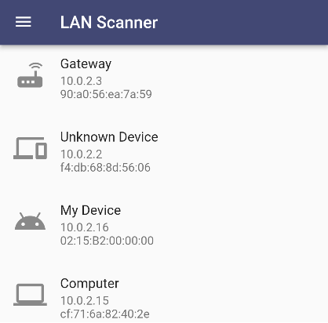
Lan Scanner Page
Most of the code was implemented in the LanScannerController so what was left was only the UI code as following:
AGENDA
Introduction
Background Review
System Analysis
System Design
Implementation
Testing
Conclusion
RefreshIndicator(
onRefresh: _lanScannerController.scanNetwork,
child: GetBuilder<LanScannerController>(
builder: (_) => Container(
width: double.infinity,
height: double.infinity,
child: ListView(
children: [ ..._lanScannerController.getDevicesList
.map((dev) => ListTile(
title: Text(dev.name),
subtitle: Text(dev.ip + "\n" + dev.mac),
leading: Icon(
getDevIcon(dev.type),
size: 40.0,
),
isThreeLine: true,
))
.toList(), ] ) ), ) ),

Slide 49
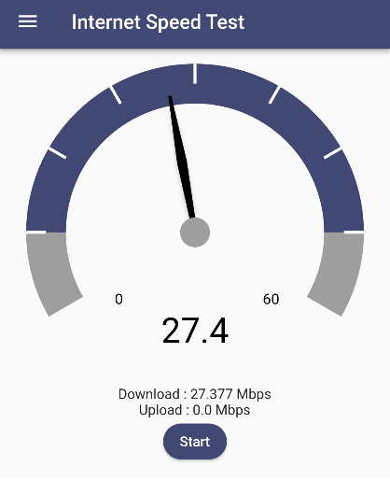
Speed test Page
The UI code was as following:
AGENDA
Introduction
Background Review
System Analysis
System Design
Implementation
Testing
Conclusion
GetBuilder<SpeedTestController>(
init: SpeedTestController(),
builder: (controller) {
return Column(
children: [
Padding(
padding: EdgeInsets.only(top: 35.0,left: 30.0, right: 30.0,bottom: 5.0),
child: SizedBox(
width: 300,
height: 300,
child: SpeedOMeter(
start: controller.start,
end: controller.end,
highlightStart: 0.125,
highlightEnd: 0.875,
themeData: ThemeData(
primaryColor: Themes.primaryColor,
// accentColor: Colors.black,
backgroundColor: Colors.grey,
),
eventObservable: controller.eventObservable),
), ),
Text("Download".tr+" : " + controller.downSpeed.toString() +' '+ controller.downUnit.tr),
Text("Upload".tr+" : " + controller.upSpeed.toString() +' '+ controller.upUnit.tr),
ElevatedButton(onPressed: controller.speed_test, child: Text("Start".tr)) ], ); }, ),

Slide 50
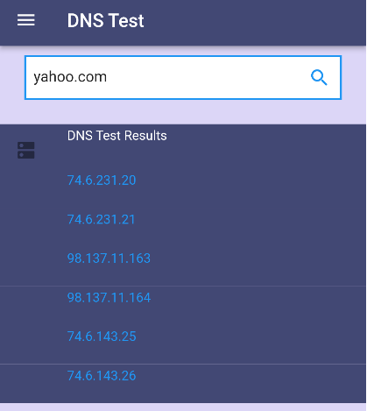
DNS Test Page
The UI code was as following:
AGENDA
Introduction
Background Review
System Analysis
System Design
Implementation
Testing
Conclusion
ListView.builder(
shrinkWrap: true,
itemCount: controller.googleDnsResultList.length,
itemBuilder: (context, index) {
return GestureDetector(
onTap: () {
Clipboard.setData(ClipboardData(
text: controller.googleDnsResultList[index], ));
ScaffoldMessenger.of(context).showSnackBar(
SnackBar(content: Text("IP Copied to clipboard".tr)), ); },
child: ListTile(
tileColor: Themes.primaryColor,
leading: index == 0?Icon(Icons.dns):SizedBox(width: 24.0),
title: index == 0 ? Column(
crossAxisAlignment: CrossAxisAlignment.start,
children: [
Text("DNS Test Results".tr+"\n\n",
style: textStyle, ), ], ) : SizedBox.shrink(),
subtitle: index >= 0
? Padding(
padding:EdgeInsets.only(bottom:18.0,
child: Text(
controller.googleDnsResultList[index],
style: TextStyle(color:Colors.blue),
), ) : null,
),);
},
),

Slide 51
Ping Test Page
The UI code was as following:
AGENDA
Introduction
Background Review
System Analysis
System Design
Implementation
Testing
Conclusion
Padding(
padding: EdgeInsets.all(20),
child: Column(
mainAxisAlignment: MainAxisAlignment.center,
children: [
TextField(
controller: pingController.urlController,
decoration: InputDecoration(
labelText: 'Hostname/IP',
border: OutlineInputBorder(),
),
),
SizedBox(height: 20),
ElevatedButton(
onPressed: () => pingController.doPing(),
child: Text('Start Test '.tr),
),
SizedBox(height: 20),
Obx(() {
final pingResults = pingController.pingResults;
if (pingResults.length == 5) {
final transmitted = pingController.transmittedPackets;
final lost = pingController.lostPackets;
final percentage = lost > 0 ? lost / transmitted.toInt() * 100 : 0;
WidgetsBinding.instance.addPostFrameCallback((_) {

Slide 52
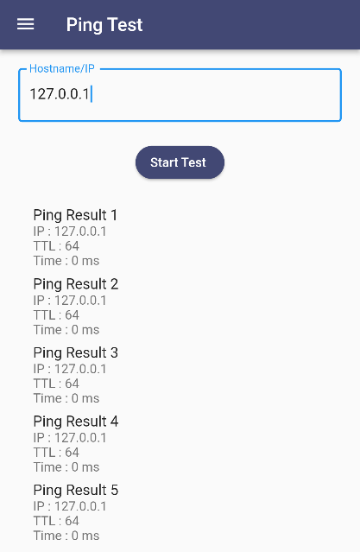
showDialog(
context: context,
builder: (_) => AlertDialog(
title: Text("Ping Summary".tr),
backgroundColor:Themes.backgroundColor ,
content: Text(
'Transmitted Packets'.tr+ ': $transmitted\n'+
'Lost Packets'.tr +
': $lost \n'+
'Packets Percentage loss'.tr+
':${percentage.toStringAsFixed(2)}%'.tr,
),
actions: <Widget>[
ElevatedButton(
onPressed: () {
Navigator.of(context).pop();
},
child: Text('OK'.tr),
),
],
),
);
});
}
return Expanded(
child: ListView.builder(
itemCount: pingResults.length,
itemBuilder: (context, index) {
final result = pingResults[index];
return ListTile(
title: Text('Ping Result'.tr +' ${index +1}'),
subtitle: Column(
crossAxisAlignment:CrossAxisAlignment.start,
children: [
Text('IP'.tr +':${result.response?.ip}'),
Text('TTL'.tr+':${result.response?.ttl}'),
Text('Time'.tr +': ${result.response?.time?.inMilliseconds ?? 'N/A'}' + ' ms'.tr),],), ); }, ), );}),],),),
AGENDA
Introduction
Background Review
System Analysis
System Design
Implementation
Testing
Conclusion

Slide 53
Data Usage Page
The UI code was as following:
-Selection Switch to select Wifi Usage or Data Usage
AGENDA
Introduction
Background Review
System Analysis
System Design
Implementation
Testing
Conclusion
Row(
mainAxisAlignment: MainAxisAlignment.center,
children: [
Text("Mobile usage".tr),
ObxValue(
(p0) => Switch(
value:_dataUsageController.wifiOrData.value,
activeColor: Colors.deepPurple,
inactiveThumbColor: Colors.blue,
inactiveTrackColor: Colors.lightBlueAccent,
onChanged: (val) {
_dataUsageController.wifiOrData.value=val;
}),
_dataUsageController.wifiOrData),
Text("WIFI usage".tr),
],
),

Slide 54
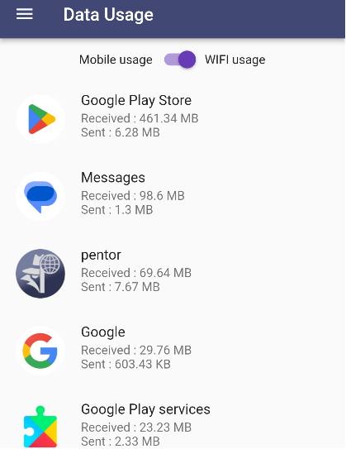
-Actual applications list with its sent and received bytes
AGENDA
Obx(() {
return FutureBuilder(
future: _dataUsageController.wifiOrData.value
? _dataUsageController.wifiAppsList
: _dataUsageController.mobileAppsList,
builder: (_, snapshot) {
if (snapshot.connectionState == ConnectionState.done) {
if (snapshot.hasData) {
List<DataUsageModel> appsList =
snapshot.data as List<DataUsageModel>;
return SizedBox(
width: double.infinity,
height: 620.0,
child: ListView(
children: [
...appsList.map((app) {
num recvVal = _dataUsageController
.round_data(app.received!);
String recvUnit = _dataUsageController
.data_unit(app.received!);
num sentVal =
_dataUsageController.round_data(app.sent!);
String sentUnit =
_dataUsageController.data_unit(app.sent!);
return ListTile(
title: Text(app.appName!),
leading: Container(
height: 60,
width: 60,
decoration: BoxDecoration(
image: DecorationImage(
image: MemoryImage(app.appIconBytes!),
),
Introduction
Background Review
System Analysis
System Design
Implementation
Testing
Conclusion

Slide 55


Settings Page
The UI code was as following:
The settings page contains the following:
-Tile to switch the application language
AGENDA
Introduction
Background Review
System Analysis
System Design
Implementation
Testing
Conclusion
ListTile buildLanguageTile() {
return ListTile(
title: Text("Language".tr),
leading: const Icon(Icons.language, size: 40.0),
subtitle: GetBuilder<LocaleController>(builder: (_) {
return Text(localeCtrl.language.tr);
}),
onTap: localeCtrl.switchLang,
);
}
-Tile to switch between light and dark themes
GetBuilder<SettingController> buildThemeTile() {
return GetBuilder<SettingController>(builder: (context) {
return ListTile(
title: Text("Theme".tr),
subtitle: Text(settingController.theme_str.tr),
leading: Icon(
settingController.theme_str == 'light'
? Icons.light_mode
: Icons.dark_mode,
size: 40.0,
),
onTap: settingController.switchTheme,
);
});
}

Slide 56
AGENDA
Introduction
Background Review
System Analysis
System Design
Implementation
Testing
Conclusion

Slide 57
AGENDA
Introduction
Background Review
System Analysis
System Design
Implementation
Testing
Conclusion
Testing

Slide 58
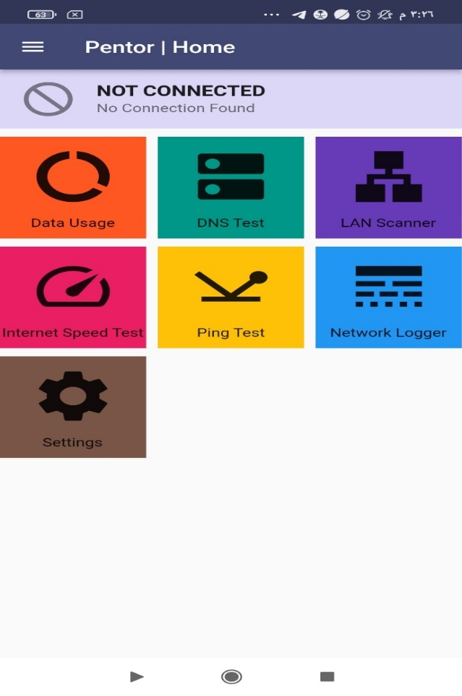
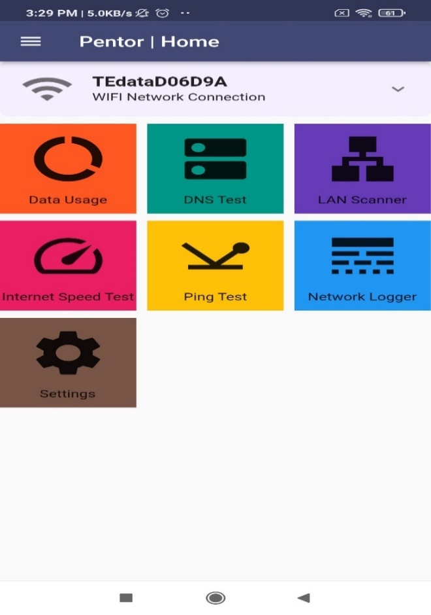
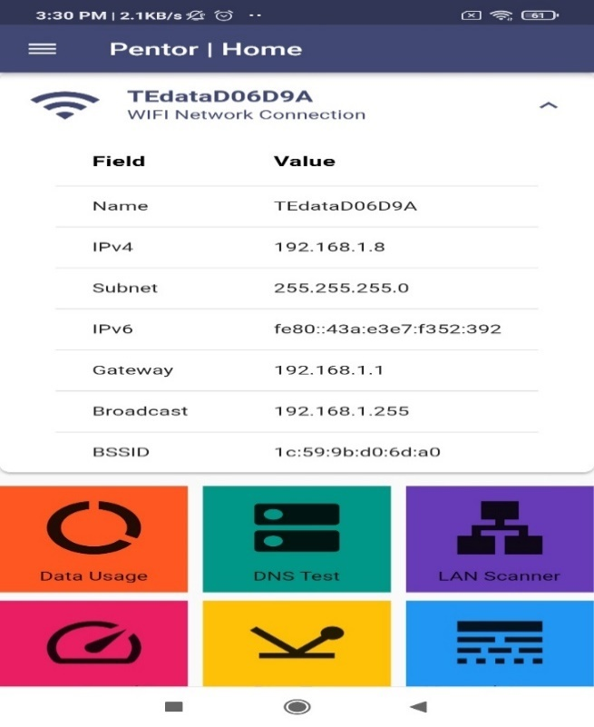
Running Examples
AGENDA
Introduction
Background Review
System Analysis
System Design
Implementation
Testing
Conclusion
Network Info:
Not connected to a network
Connected to WIFI

Slide 59

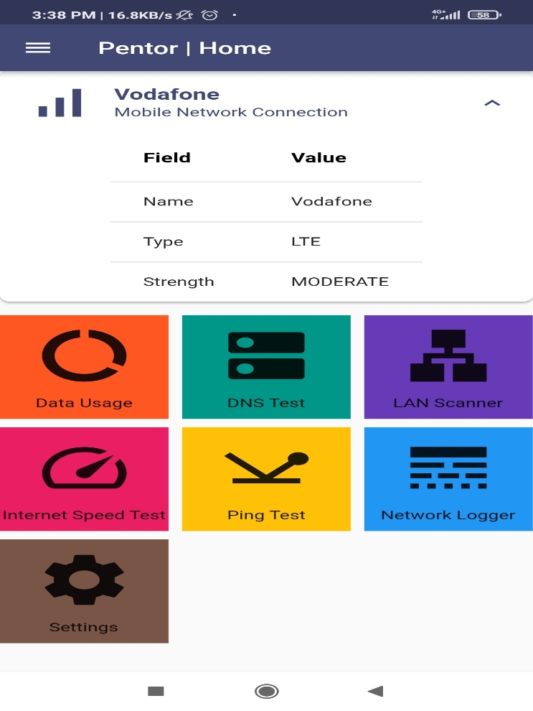
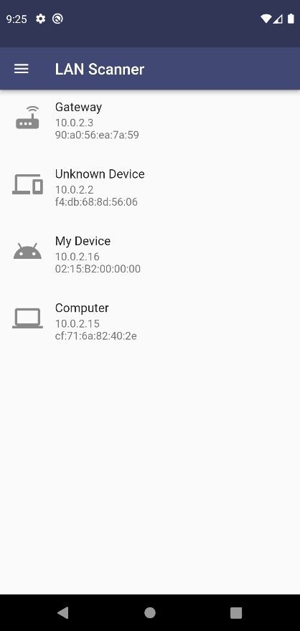
Running Examples
AGENDA
Introduction
Background Review
System Analysis
System Design
Implementation
Testing
Conclusion
Network Info:
Connected to mobile data
Lan Scanner:

Slide 60
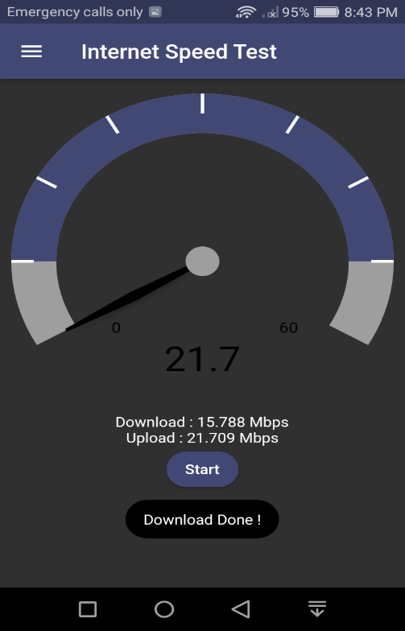

Running Examples
AGENDA
Introduction
Background Review
System Analysis
System Design
Implementation
Testing
Conclusion
Internet Speed Test:

Slide 61
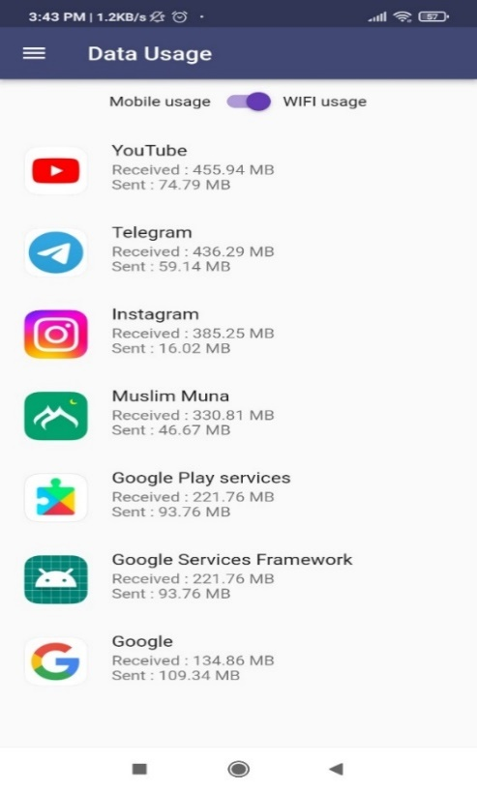
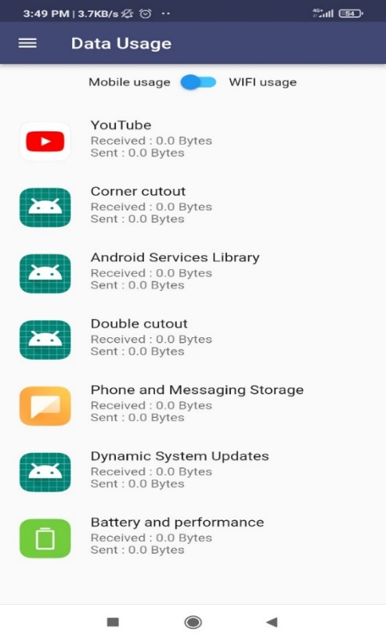
Running Examples
AGENDA
Introduction
Background Review
System Analysis
System Design
Implementation
Testing
Conclusion
Data Usage:

Slide 62
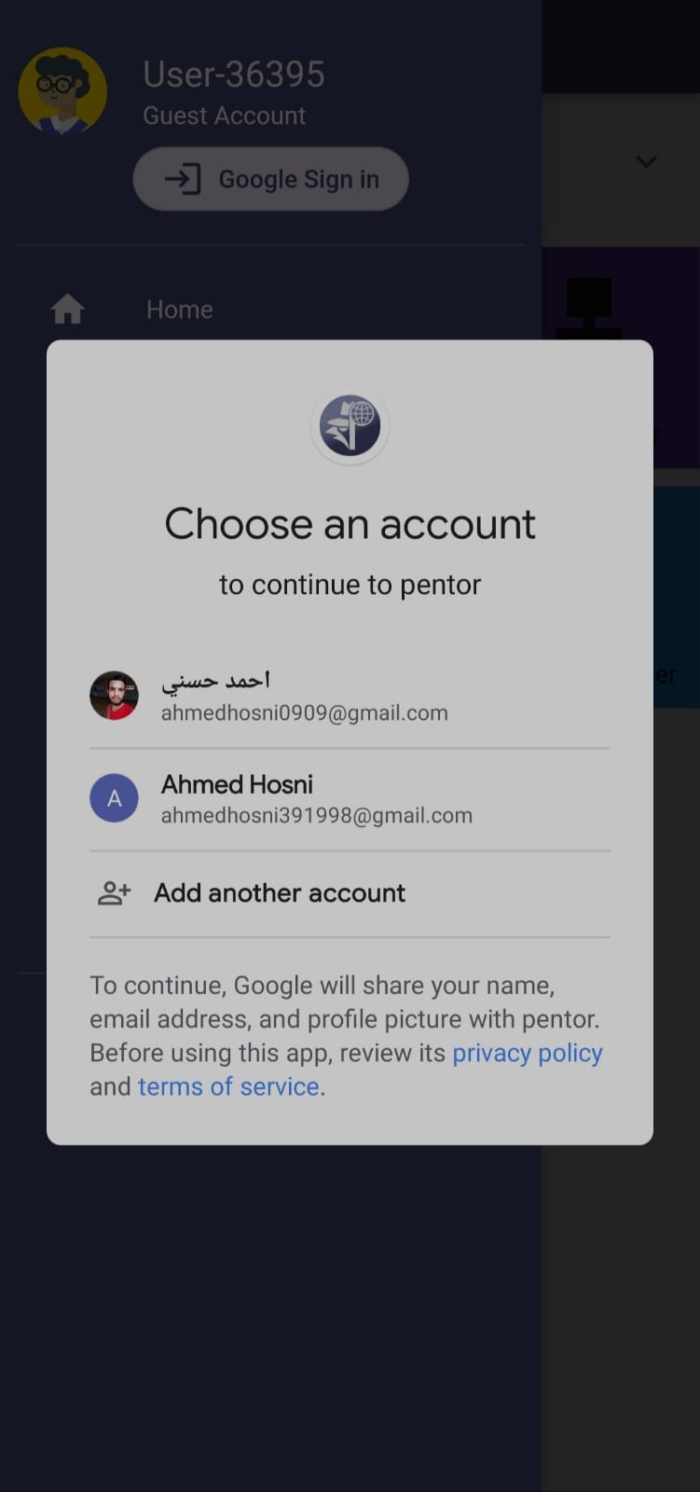
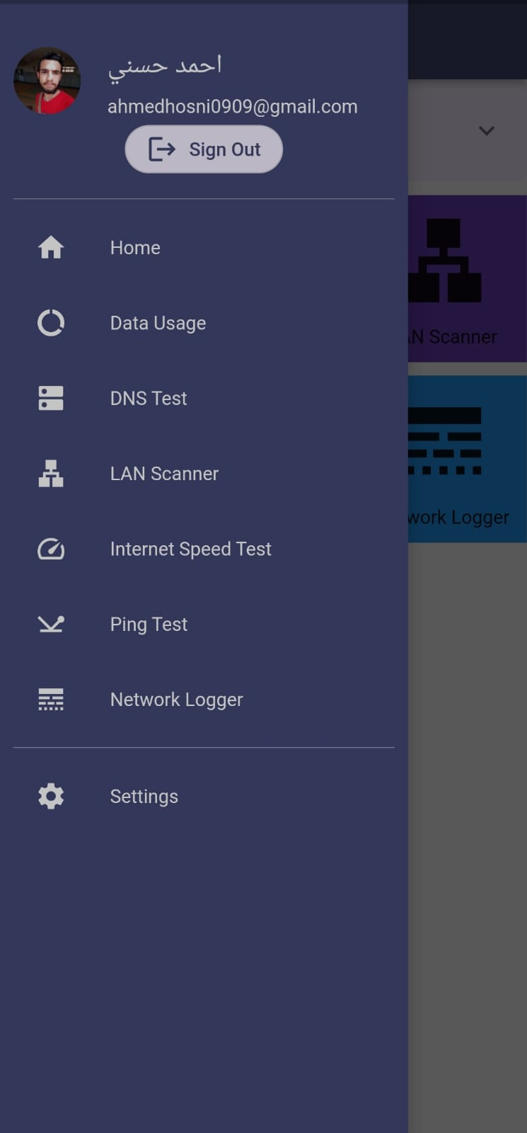
Running Examples
AGENDA
Introduction
Background Review
System Analysis
System Design
Implementation
Testing
Conclusion
Google Sign In:

Slide 63
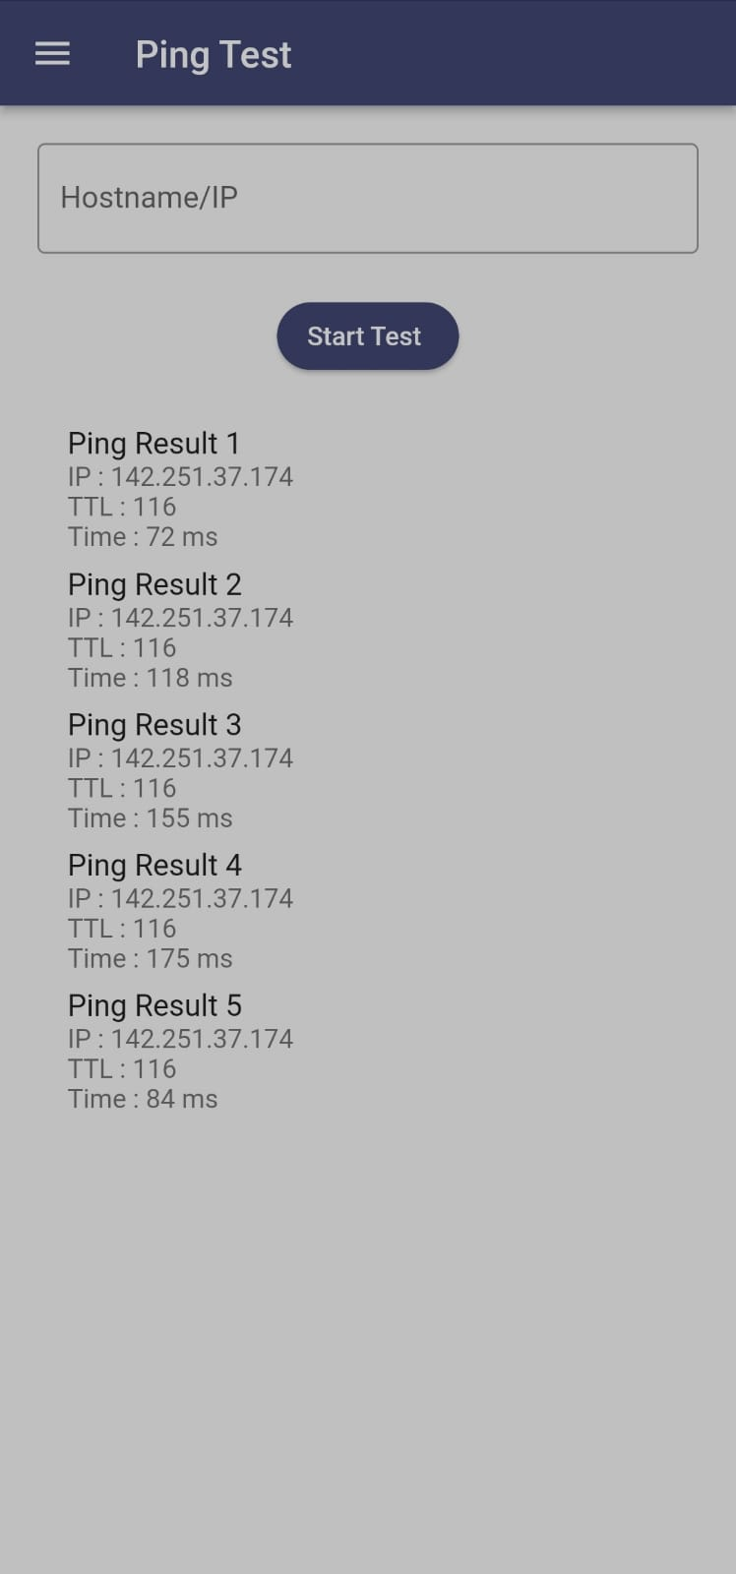
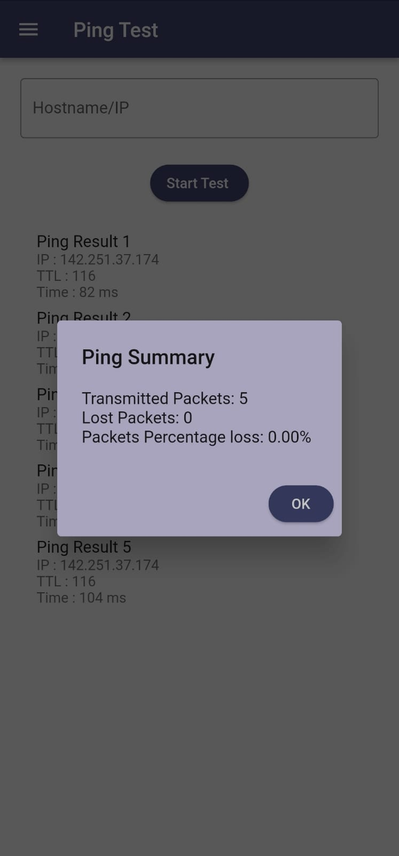
Running Examples
AGENDA
Introduction
Background Review
System Analysis
System Design
Implementation
Testing
Conclusion
Ping Test:

Slide 64
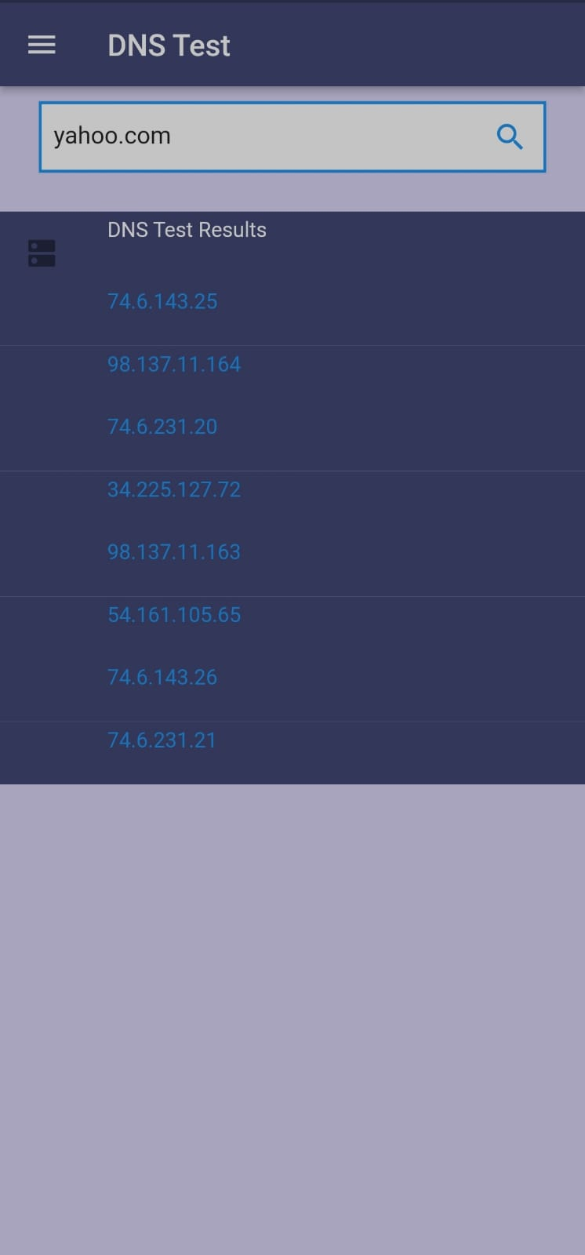
Running Examples
AGENDA
Introduction
Background Review
System Analysis
System Design
Implementation
Testing
Conclusion
DNS Test:

Slide 65
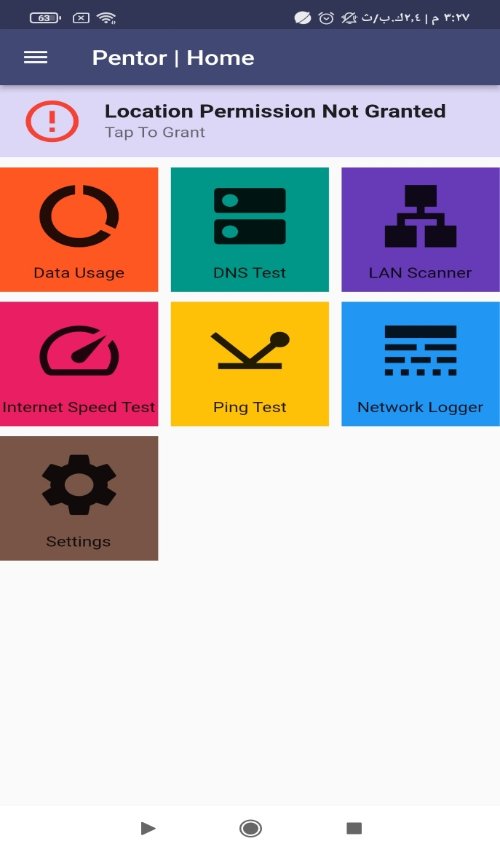
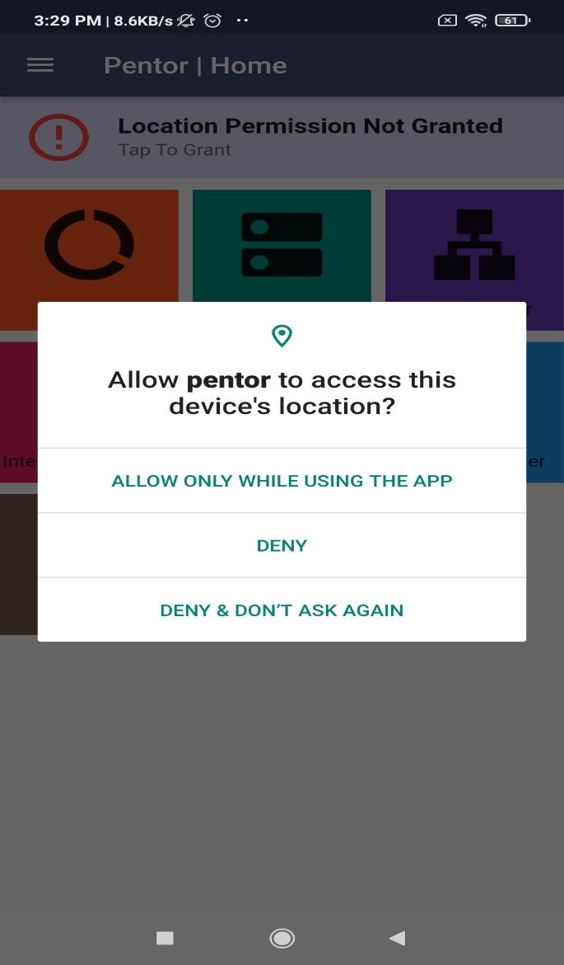
Validation
AGENDA
Introduction
Background Review
System Analysis
System Design
Implementation
Testing
Conclusion
Network Info:
Connected to WIFI

Slide 66
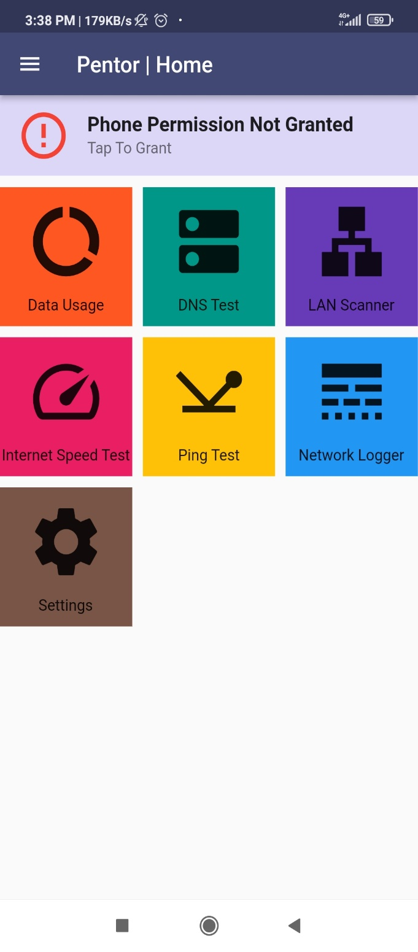
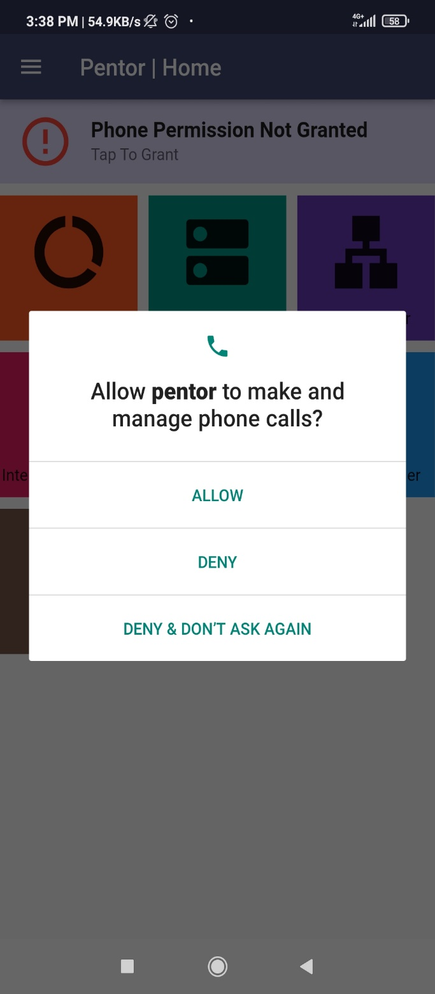
Validation
AGENDA
Introduction
Background Review
System Analysis
System Design
Implementation
Testing
Conclusion
Network Info:
Connected to mobile data

Slide 67


Validation
AGENDA
Introduction
Background Review
System Analysis
System Design
Implementation
Testing
Conclusion
Lan Scanner:
Internet Speed Test:

Slide 68

Validation
AGENDA
Introduction
Background Review
System Analysis
System Design
Implementation
Testing
Conclusion
Data Usage:

Slide 69


Validation
AGENDA
Introduction
Background Review
System Analysis
System Design
Implementation
Testing
Conclusion
Ping Test:
DNS Test:

Slide 70
AGENDA
Introduction
Background Review
System Analysis
System Design
Implementation
Testing
Conclusion
Conclusion

Slide 71
AGENDA
Faced Problems
Introduction
Background Review
System Analysis
System Design
Implementation
Testing
Conclusion
Designing an intuitive user interface.
Integrating with different network protocols.
Ensuring security.
Platform limitations.

Slide 72
AGENDA
Benefits and Findings
Introduction
Background Review
System Analysis
System Design
Implementation
Testing
Conclusion
Team work : improved technical and soft skills.
Using Waterfall allowed all team to plan each phase of the project in detail.
Using Flutter reduced development time and effort.
Firebase Integrating allowed for easier implementation of features such as authentication, real-time database updates, and cloud storage.
Recommendations and Future Enhancements
Router setting.
Advanced analytics.
Integration with third-party tools.
Multilanguage support.

Slide 73
References
AGENDA
Flutter documentation [https://docs.flutter.dev]
Official Flutter package repository [https://pub.dev/]
Android Developer Guides [https://developer.android.com/docs]
Firebase documentation: [https://firebase.google.com/docs/flutter/setup]
"Best Practices for Mobile App Development" - AWS Whitepaper
Mobile Backend as a Service (MBaaS) Market - Growth Trends Forecast (2020 - 2025)
Introduction
Background Review
System Analysis
System Design
Implementation
Testing
Conclusion
Tools
Dart: Programming Language.
Flutter Framework: for Cross platform development
Android Studio: for Code Editing and simulation.
Google Firebase: for cloud storage.
Draw.IO: for Diagrams.
Git & GitHub: for version control.
Microsoft word: for reports and documentation.
Microsoft Planner: for task scheduling.
Onlinegantt : For Gantt Charts
IconFinder : For Icons in Figures

Slide 74
Thank You
Dr. Maha Tolba | Prof. Nawal Alfeshawy | Dr. Sonia Hashish
Our
Families & Friends

